Slide 1
Scrum
An agile approach

Slide 2
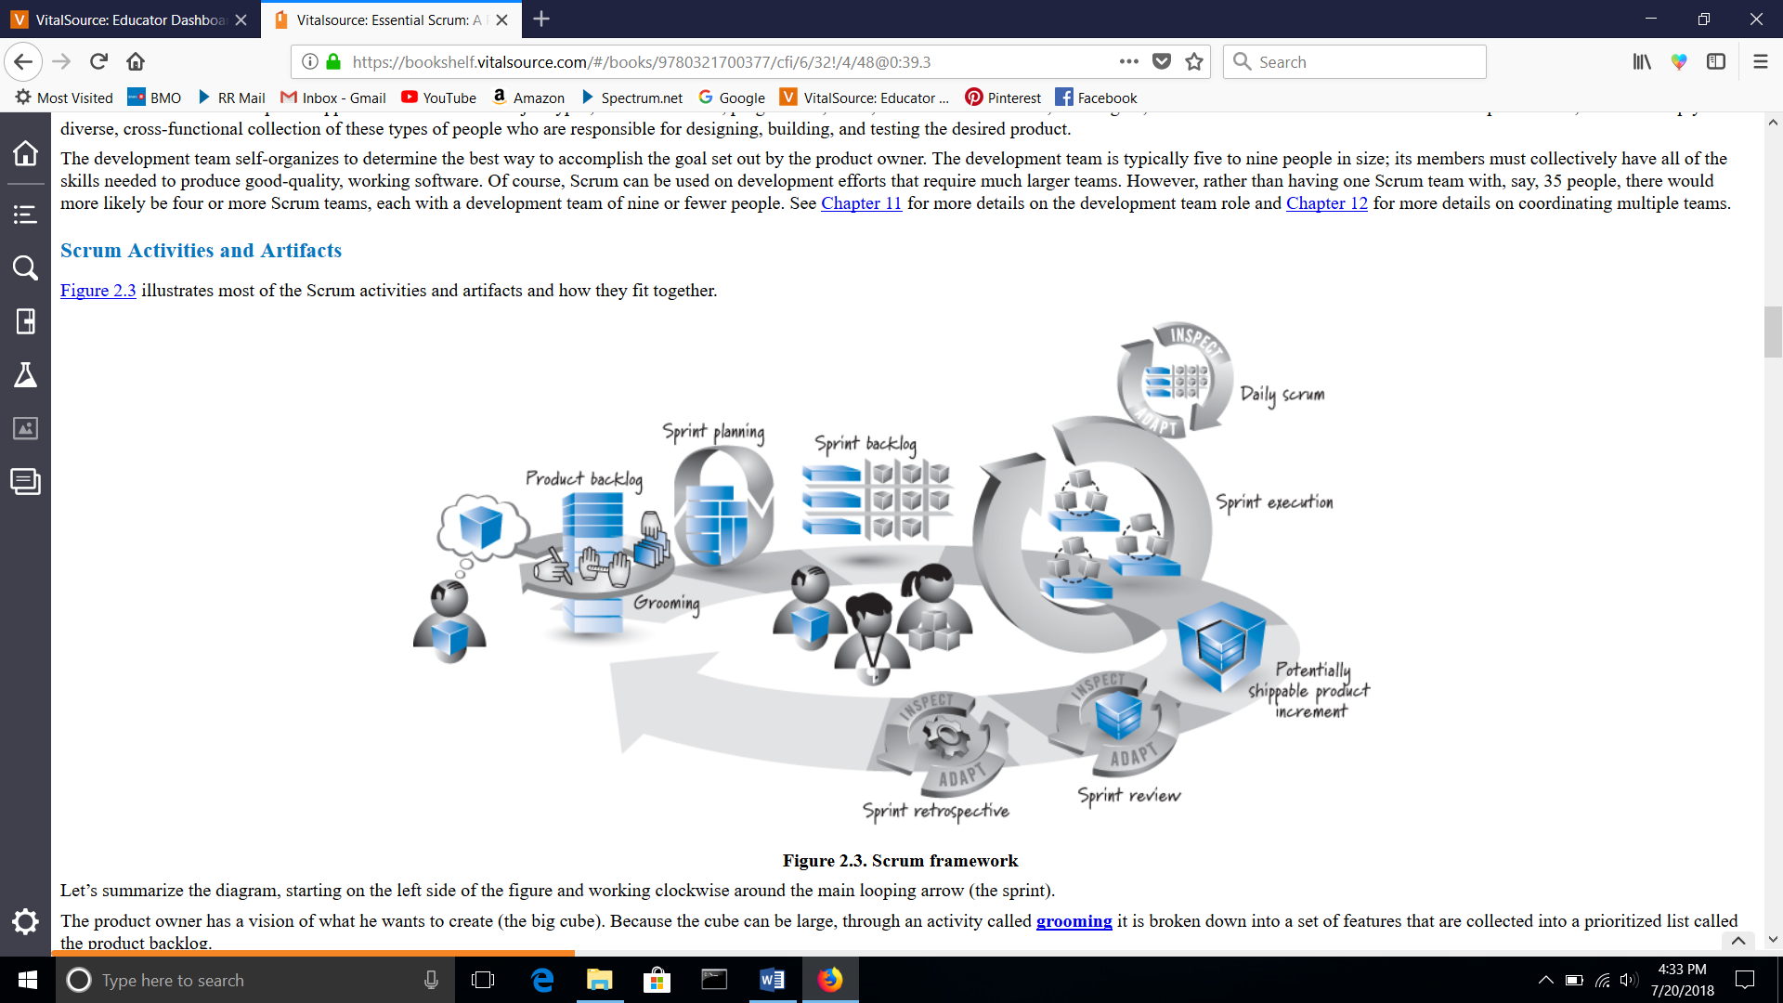
Scrum

Slide 3
Scrum
A lightweight process framework for agile development
A particular set of practices that must be followed in order for a process to be consistent.
(Scrum – sprints)
(XP – pair programming)
The overhead of the process is kept as small as possible, to maximize the amount of productive time available for getting work done.

Slide 4
References – download these and save!
Scrum Guide
https://www.scrum.org/resources/scrum-guide
Scrum Reference Card
https://www.collab.net/sites/default/files/uploads/CollabNet_scrumreferencecard.pdf

Slide 5
Outline
Scrum: definition, theory, values, advantages, disadvantages
Scrum team and responsibilities
Scrum artifacts: Product Backlog and Sprint Backlog
Sprint Review, Sprint Retrospective, Daily Scrum
Sprint, Sprint Planning

Slide 6
Scrum
Developed by Ken Schwaber and Jeff Sutherland in the early 1990’s
A framework for developing, delivering, and sustaining complex products
Effective in iterative and incremental knowledge transfer
Scrum teams are small, highly flexible and adaptive
Scrum is an Agile process framework

Slide 7
Scrum theory
Founded on Empiricism – knowledge comes from experience and making decisions is based on what is known
3 Pillars of every implementation of empirical process control:
Transparency
Inspection
Adaptation

Slide 8
Scrum theory – The 3 Pillars
Transparency – visibility to those responsible for the outcome
Observers can share a common understanding of what’s seen
Inspection – inspect artifacts
Frequently inspect the artifacts so the team can progress towards their goal
Adaptation – ability to make adjustments quickly to minimize further deviation

Slide 9
Scrum values
Focus – on the work of the sprint and the goals of the team
Openness – be open about the work and the challenges
Respect – respect each other
Commitment – to achieving the goal
Courage – work through tough problems
FORCC

Slide 10
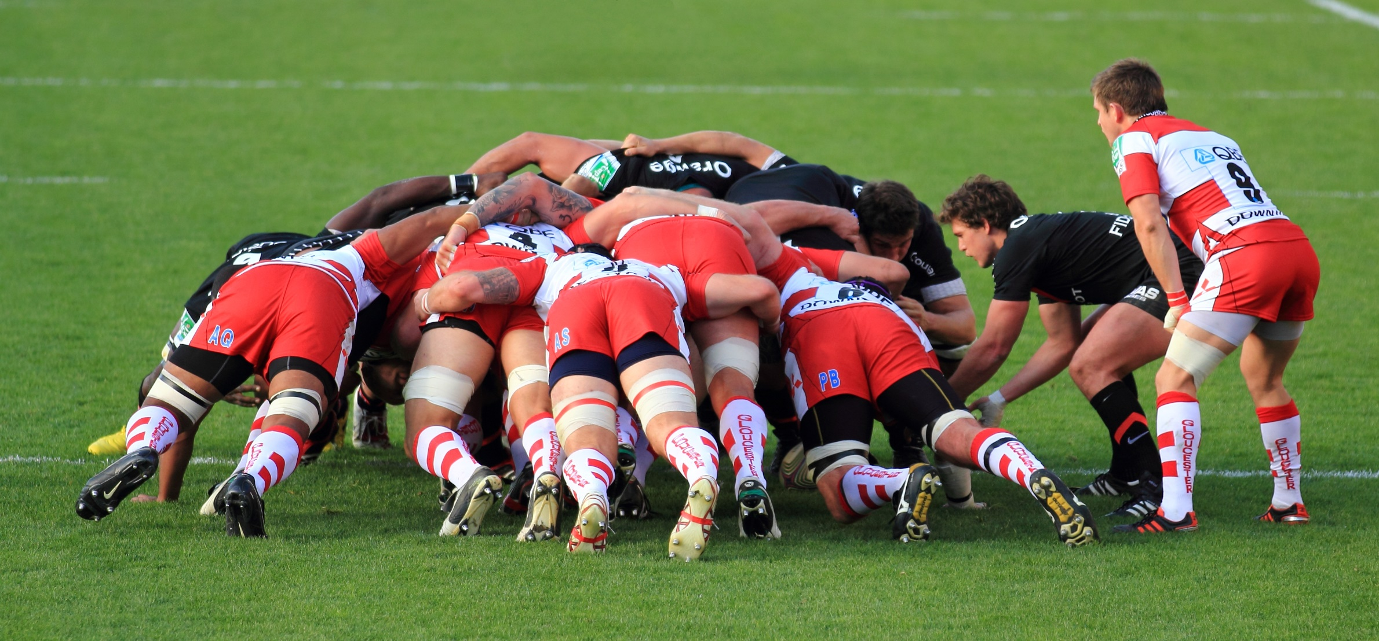
Why is rugby compared to Scrum?
“It is a metaphor to reflect the degree of cooperation needed to succeed”

Slide 11
Scrum – short for scrummage
A method of restarting play in rugby
Involves players packing closely together with their heads down and attempting to gain possession of the ball
Continually think of your alignment in relation to the ball carrier and any players in between. Work hard to be available when needed.

Slide 12
RUGBY | SCRUM
Looks like Chaos | Doesn’t need the rigidity of Waterfall; It can be flexible and respond to the changing needs of the business
Players act as a tightly cohesive unit that pushes together to put the ball into play | A collaborative team that is delivering business value in a tightly coordinated fashion
As a player, you don’t carry the ball the whole time; you can’t be a play maker all the time. | Empowered agile teams are not told how to do the work; they are self-organizing and determine what needs to be done
The Scrum Half directs traffic between the forwards in the scrum | The Scrum Master coaches the team members to foster communication and collaboration
Offensive open rugby play repeats itself through phase after phase of play | Within a fixed amount of time, the team will plan, work, and review on a regular basis

Slide 13
Scrum team
Product Owner Development Team Scrum Master
Scrum Teams deliver incremental products of ‘Done’ to ensure a useful version of the working product is always available
self-organizing – teams choose how to accomplish work
cross-functional – teams have all competencies needed to accomplish the work

Slide 14
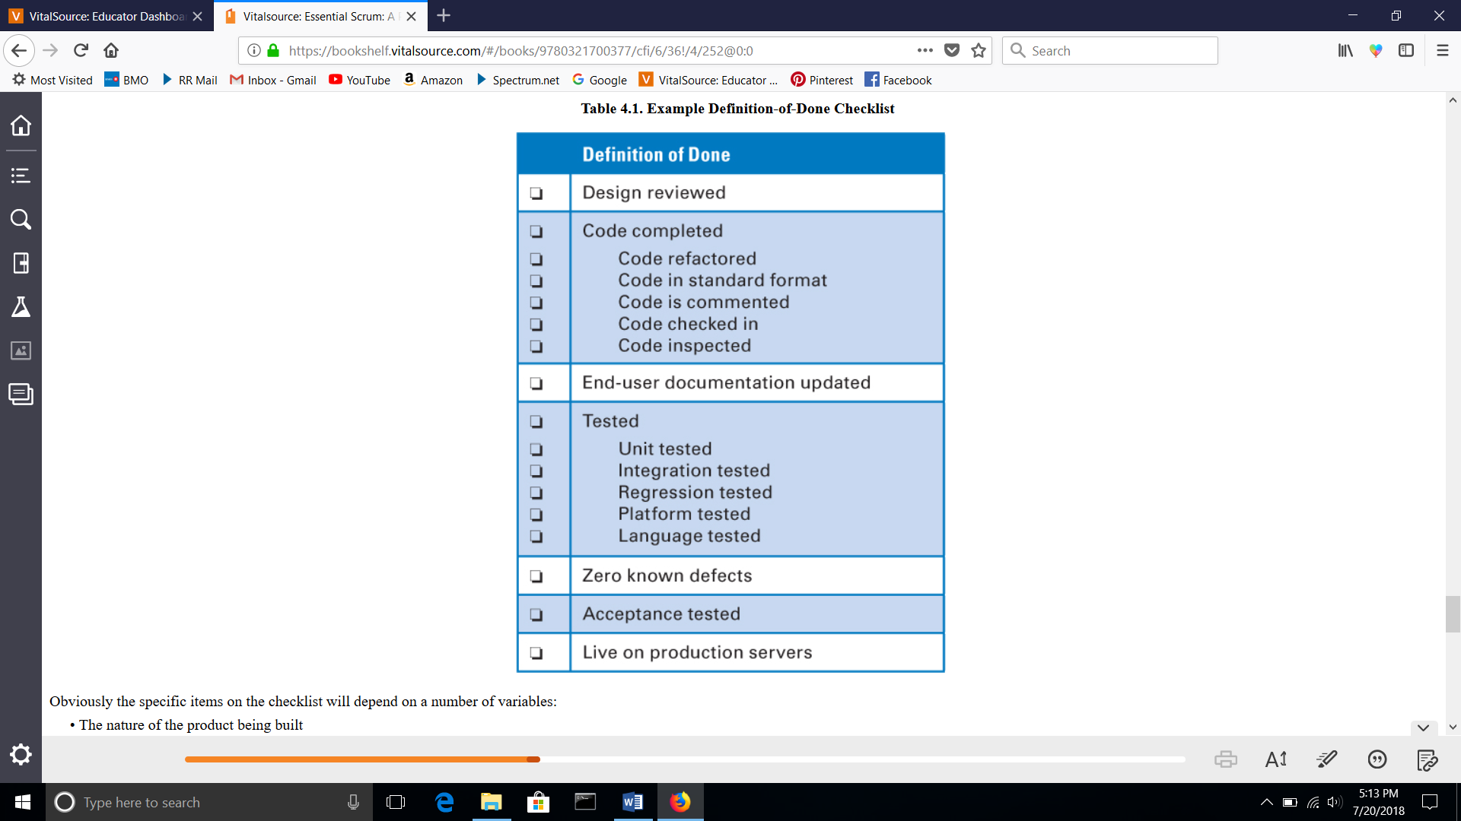
Definition of done checklist

Slide 15
MVP – Minimum Viable product
Minimum amount of work you need to do, to produce a product that you can offer to customers
Allows you to observe their actual behavior with the product or service
May be no more than a landing page, but is fully manual behind the scenes
Seeing what people actually do with respect to a product is much more reliable than asking people what they would do

Slide 16
Scrum team
Product Owner – one person responsible for managing the product backlog
Ordering the items in the product backlog
Ensuring the PB is visible, transparent, and clear
Shows what the team will work on next

Slide 17
Scrum team
Development Team does the work of delivering a potentially reusable increment of ‘Done’ at the end of each Sprint
organize and manage their own work
Are self-organizing – no one tells them how to turn the PB into releasable functionality
Between 3 – 9 cross-functional members

Slide 18
Scrum team
Scrum Master
Promotes and supports Scrum
Ensures that goals and scope are understood by everyone on the Scrum team
Helps the Scrum Team understand the Product Backlog
Coaches the development team in self-organizing and cross-functionality
Coaches the organization in adapting to Scrum
Removes impediments to the development team’s progress

Slide 19
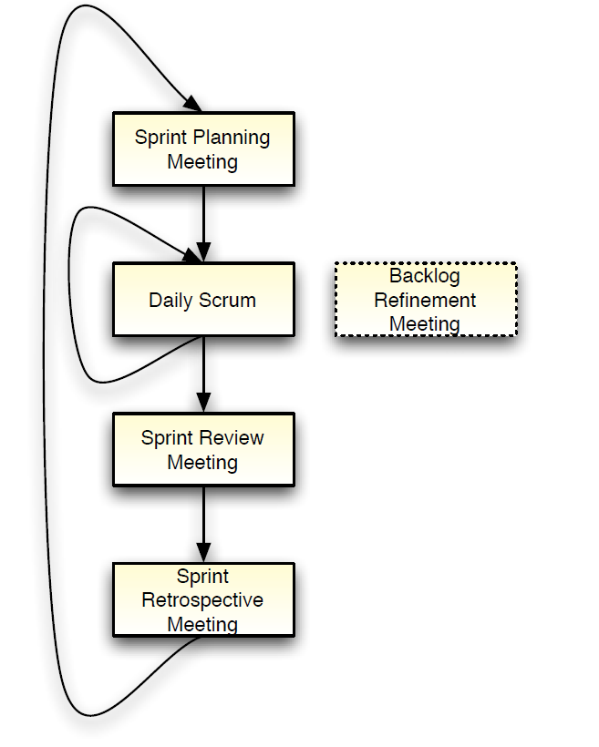
Scrum Events
Sprint planning
Spring review
Sprint retrospective
Daily scrum meeting
Backlog Refinement Meeting

Slide 20
Scrum

Slide 21
Sprint planning Meeting
At the beginning of each sprint
Negotiate which product backlog items, PBI’s, they will convert to a working product during the sprint
The Product Owner will declare which items are most important
The Dev Team will select the amount of work they feel they can implement
The Dev Team pulls work from the Product Backlog into the Sprint Backlog
If the top of the PB hasn’t been refined, it could be done during this meeting

Slide 22
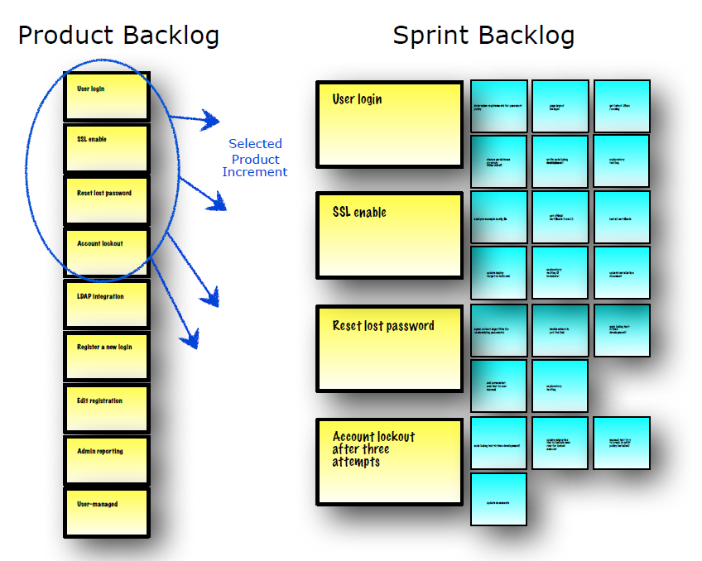
Sprint planning
Team selects items from the product backlog they can commit to completing
Sprint backlog is created
Team determines How:
Tasks: identified and each is estimated

Slide 23
Scrum

Slide 24
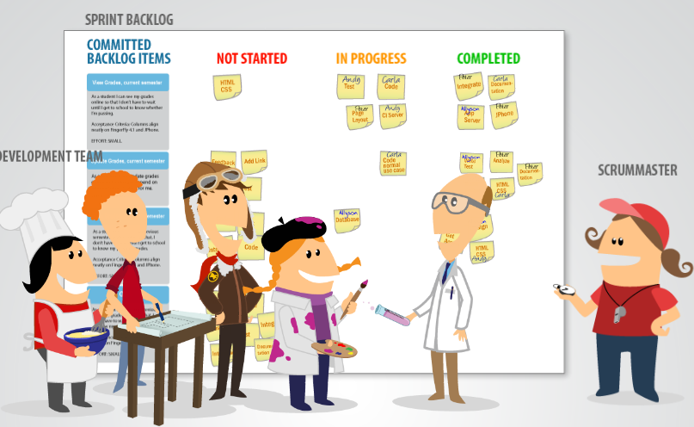
Daily Scrum
Daily Standup Meeting (same time & place)
15-minutes
Not for problem solving
Daily inspect (their progress) and
Adapt to help the team
Scrum Master facilitates
The Team answers questions
Intended to disrupt old habits of working separately

Slide 25
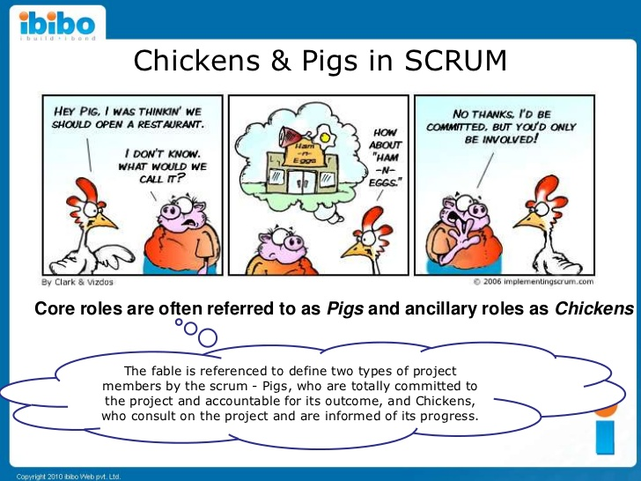
Who participates in the daily scrum meeting
At the daily scrum, only the pigs should talk.
The chickens should attend as observers.
Thoughts….everyone on the scrum team is a pig!

Slide 26
Daily scrum
Answers 3 questions
What did you do yesterday?
What will you do today?
Is anything in your way?
The daily scrum is not a status meeting for the Scrum Master
The daily scrum is for commitments in front of peers

Slide 27
Scrum

Slide 28
Sprint Review
At the end of the Sprint to demonstrate a working product increment
Inspect and adopt the product as it emerges
Team presents what it accomplished during the sprint to everyone
Typically takes the form of a demo of the just completed features or underlying architecture – No slides – No reports
Informal, 2-hour prep time rule
Whole team participates
Incomplete items are returned to the Product Backlog

Slide 29
Note
This Iterative development shows a value-driven approach.
It allows the creation of products that couldn’t have been specified up front in a plan-driven approach.

Slide 30
Scrum

Slide 31
Sprint retrospective
At the end of every Sprint; after the sprint review
The team Inspects their behavior and
Takes action to Adopt the process for future sprints
Periodically take a look at what is and is not working
Typically 15–30 minutes
Whole team participates
Scrum Master, Product owner, Development team
Possibly customers and others

Slide 32
Sprint retrospective
Many approaches exist, but the key is to answer the following:
What worked well this sprint that we want to continue doing?
What didn’t work well this sprint that we should stop doing?
What should we start doing or improve?

Slide 33
Sprint retrospective
It should be an alternative to the fearful meetings of the past
It should be an environment of psychological safety
No blaming or hostility
The Scrum Master should use a variety of techniques to facilitate
Develop actions to take the team to the next level

Slide 34
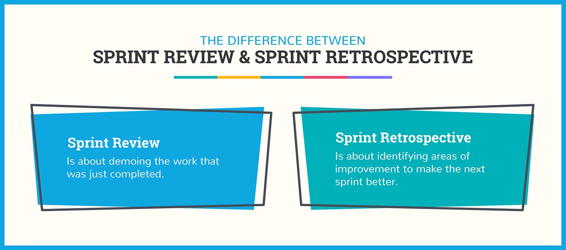

Slide 35
Backlog Refinement Meeting
Not a required event, but is a required activity
Done during the sprint to prepare for the upcoming sprint planning mtg
Most PBI’s need to be refined (they are too large or vague)
May be started with the PO and stakeholders before involving the team
PBI’s can be written in User Story Form
Agility requires splitting large Epics into user stories representing very small product features

Slide 36
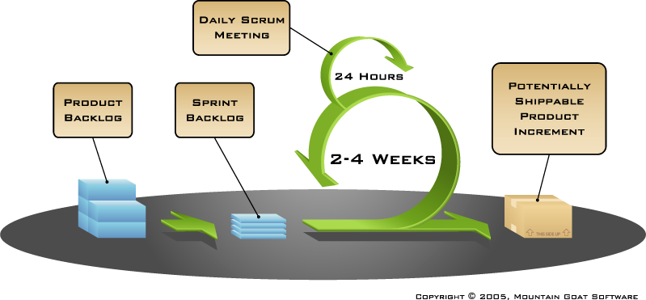
Putting it all together
Image available at www.mountaingoatsoftware.com/scrum

Slide 37
Roles and responsibilities game
Have students split into groups of 3 to 5
Give students a list of the Scrum roles and responsibilities
Indicate which responsibility fits under which Scrum Role
When the groups are done, have them review the other groups answers
Discuss discrepancies

Slide 38
Scrum artifacts
Product Backlog
Sprint Backlog
Burndown Charts

Slide 39
Scrum

Slide 40
product Backlog
Prioritized list of desired functionality
Visible to all stakeholders
Any stakeholder (including the Team) can add items
Constantly re-prioritized by the Product Owner
Constantly refined by the Scrum Team
Items at top should be smaller than items at bottom

Slide 41
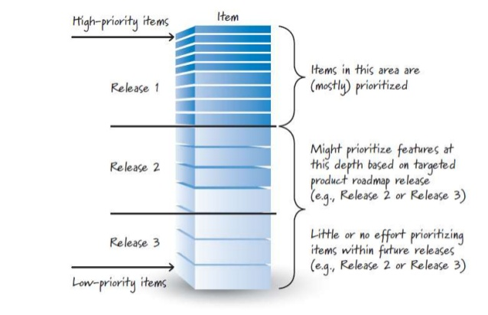
Product backlog

Slide 42
product Backlog
The backlog is never complete
It evolves as the product evolves
The first PBI’s – Requirements that are initially known and best understood
Is dynamic; it constantly changes to identify what the product needs to be appropriate, competitive, and useful

Slide 43
Product backlog
Typically, a Scrum team and its product owner begin by writing down everything they can think of for agile backlog prioritization
Can contain
Features – something the user wants
Bugs – something the user wants
Technical work – upgrade to Windows10
Knowledge acquisition – researching JavaScript libraries

Slide 44
Product backlog items - PBI
The ‘what’ more than the ‘how’ of a feature
Has a product definition of Done
May have acceptance criteria
Effort is estimated by the Dev Team usually in points
Usually written in a User Story

Slide 45
Acceptance criteria
As a user I want to pay for items in the cart with credit so it can be shipped right away
On the back of the story card, acceptance test or criteria can be created:
Test with Visa, MasterCard and American Express (pass)
Test with Diner’s Club (fail)
Test with good, bad and missing card ID numbers from the back of the card
•Test with expired cards
•Test with different purchase amounts (including one over the card’s limit)

Slide 46
User story
Short, simple descriptions of a feature
Told from the perspective of the person who desires the new capability
As a < type of user >, I want < some goal > so that < some reason >
Can be written on index cards or sticky notes or arranged on walls or tables
They strongly shift the focus from writing about features to discussing them
In fact, these discussions are more important than whatever text is written

Slide 47
User stories – Three C’s
Cards are traditionally used to write stories and may be annotated with estimates or notes
Conversations with the product owner help to bring out the details behind the story
Confirmation comes with acceptance testing to ensure the story was coded correctly
Shift the focus from writing to talking

Slide 48
Example: create a travel website
Start by brainstorming with stakeholders on what features they want:
Make reservations
Photos available
Frequent flyer points
Start creating the Product Backlog

Slide 49
Example: create a travel website
Create stories from the Product Backlog Items/features
As a User, I want to reserve a hotel room so that….
As a user, I want to cancel a reservation
As a vacation traveler, I want to see photos of the hotel
As a frequent visitor, I want to rebook a past trip so that I can save time

Slide 50
Example: create a travel website
Those stories should start conversation
As a user, I want to cancel a reservation:
Does the user get a full refund or partial?
Is the refund to the card or a site credit?
How far ahead can it be cancelled?
How is confirmation provided to the user?

Slide 51
Example: create a travel website
These details can become conditions of satisfaction
As a user, I can cancel a reservation
Verify that a premium member can cancel the same day without fees
Verify that a non-premium member is charged 10% for same-day cancellation
Verify that an email confirmation is sent
Verify that the hotel is notified of all cancellations

Slide 52
Example: create a travel website
Smaller stories should be created
As a premium member, I can cancel a reservation up to the last minute
As a non-premium member, I can cancel up to 24 hours in advance
As a site visitor, I am emailed a confirmation of any cancelled reservation
Goal: to write as many stories as possible at the appropriate level for the team

Slide 53
Scrum

Slide 54
Sprint backlog
Selected PBIs negotiated between the team and the Product Owner during the Sprint Planning Meeting
No changes are made during the Sprint that would endanger the Sprint Goal
Initial tasks are identified by the team during Sprint Planning Meeting
Team will find more tasks needed to meet the Sprint Goal during Sprint execution
Visible to the team
Referenced during the Daily Scrum Meeting

Slide 55
Managing the sprint backlog
Individuals sign up for work of their own choosing – work is not assigned
Estimated work remaining is updated daily
Any team member can add, delete or change the sprint backlog
If work is unclear, define a sprint backlog item with a larger amount of time and break it down later
Update work remaining as more becomes known

Slide 56
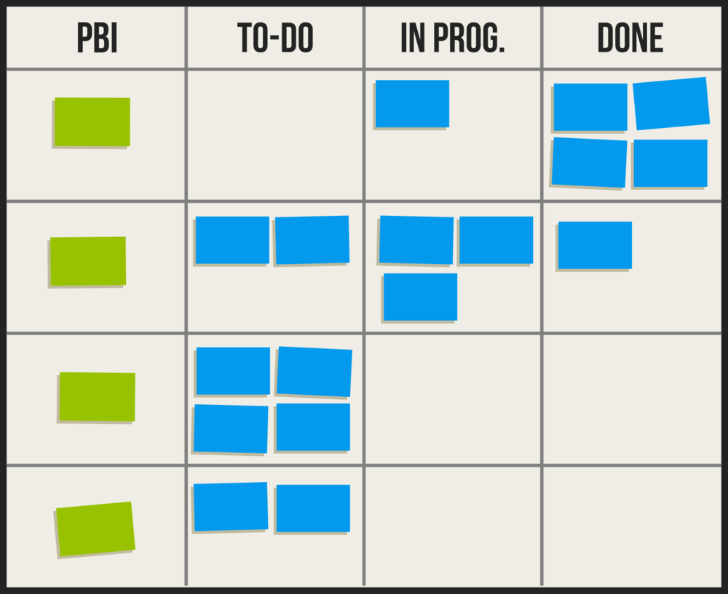
Sprint backlog

Slide 57
Burndown chart
Summation of total team work remaining within one Sprint
Updated daily
Intended to facilitate team self-organization
Seemed like a good idea in the early days of Scrum, but in practice has often been misused as a management report, inviting intervention.
The Scrum Master should discontinue use of this chart if it becomes an impediment to team self-organization.

Slide 58
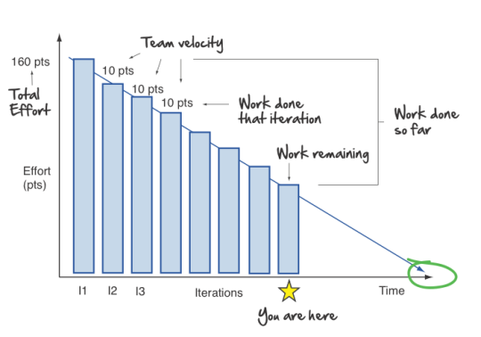
Burndown chart

Slide 59

Copyright notice
You are free:
to Share―to copy, distribute and and transmit the work
to Remix―to adapt the work
Under the following conditions
Attribution. You must attribute the work in the manner specified by the author or licensor (but not in any way that suggests that they endorse you or your use of the work).
Nothing in this license impairs or restricts the author’s moral rights.
For more information see http://creativecommons.org/licenses/by/3.0/

